Slide 1
Coding Security Tools
Dr. Maram Bani Younes

Slide 2
Outline
Port scanner
DNS Lookup
Network Scanner
ARP Spoofing
Keylogger
Hash Breaker

Slide 3
Network Security Tools
Nmap : open port and available services
Netdiscovery: Ip address and Mac address of all devices on the same network
DNS lookup: return the dns records that run the website
Hashing tool: return hashed value for any input text

Slide 4
Port scanner
Software take the IP address return all open ports in the system.

Slide 5
Simple port scanner “80 on google”
import socket
target ="172.217.21.14“
p =80 # 443
s= socket.socket(socket.AF_INET, socket.SOCK_STREAM)
s.settimeout(1)
r= s.connect_ex((target,p))
if r== 0:
service = socket.getservbyport(p)
print("...[ * {} * is open --> {} ]".format(p,service))
s.close()

Slide 6
Connect_ex
connect_ex((ip, p))
This function returns a code:
  0 if the port is open
  111 or 11 if the port is close.

Slide 7
Several ports in Google
import socket
target ="172.217.21.14“ # input
#p =80
ports =[80, 443, 21, 23, 25, 24, 56] # range
for p in ports:
s= socket.socket(socket.AF_INET, socket.SOCK_STREAM)
s.settimeout(1)
r= s.connect_ex((target,p))
if r== 0:
service = socket.getservbyport(p)
print("...[ * {} * is open --> {} ]".format(p,service))
s.close()

Slide 8
s.settimeout(1)
Control the speed of the tool
Faster less time
Slower more time

Slide 9
import socket
target ="87.248.100.216" # yahoo
#p =80
#ports =[80, 443, 21, 23, 25, 24, 56]
for p in range (100):
s= socket.socket(socket.AF_INET, socket.SOCK_STREAM)
s.settimeout(1)
r= s.connect_ex((target,p))
print("the port number: ", p)
if r== 0:
service = socket.getservbyport(p)
print("...[ * {} * is open --> {} ]".format(p,service))
s.close()

Slide 10
DNS Lookup
Takes the Ip address or URL and it returns the DSN record
Need to install DNS library
pip install dnspython
Or
pip install dnspython3

Slide 11
DNS Records
DNS records are instructions that live in authoritative DNS servers and provide information about a domain including:
  What IP address is associated with that domain.
  How to handle requests for that domain.

Slide 12
DNS Records
A record - The record that holds the IP address of a domain.
AAAA record - The record that contains the IPv6 address for a domain
MX record - Directs mail to an email server.
NS record - Stores the name server for a DNS entry.
SOA Record - Declares the most authoritative host for the zone.
PTR Record - Creates a pointer, which maps an IP address to the host name in order to do reverse lookups.
TXT Record - Permits the insertion of arbitrary text into a DNS record. These records add SPF records into a domain.

Slide 13
DNS Lookup
import dns.resolver
target = str(input("Enter Domain Name / Ip address:\n"))
types=["A", "AAAA", "MX", "NS", "SOA", "PTR", "CNAME", "TXT"]
for record in types:
d= dns.resolver.query(target, record, raise_on_no_answer=False)
if d.rrset is not None:
print(d.rrset)

Slide 14
In the code
d.rrset: convert the object d into text.
raise_on_no_answer=False: incase there is no response from the record no need to display the code

Slide 15
DNS Lookup

Slide 16
Network Scanner
Network Scanner: a tool used to find all devices on the local network including their IP address and MAC address.
Net-discovery tool: gathers the basic information of all devices connected to a LAN network. (i.e., IP and MAC address)

Slide 17
ARP
Address Resolution Protocol (ARP) is a protocol or procedure that connects IP address (dynamic address) to MAC address (fixed machine address), in a local-area network (LAN).

Slide 18
IP and MAC
To send a message on LAN we need to know the IP address and MAC address of the received message.
IP address can be obtained directly based on the applied mask on that LAN. 192.168.10.1/24
ARP protocol could be used to collect the MAC address of devices on the LAN.

Slide 19
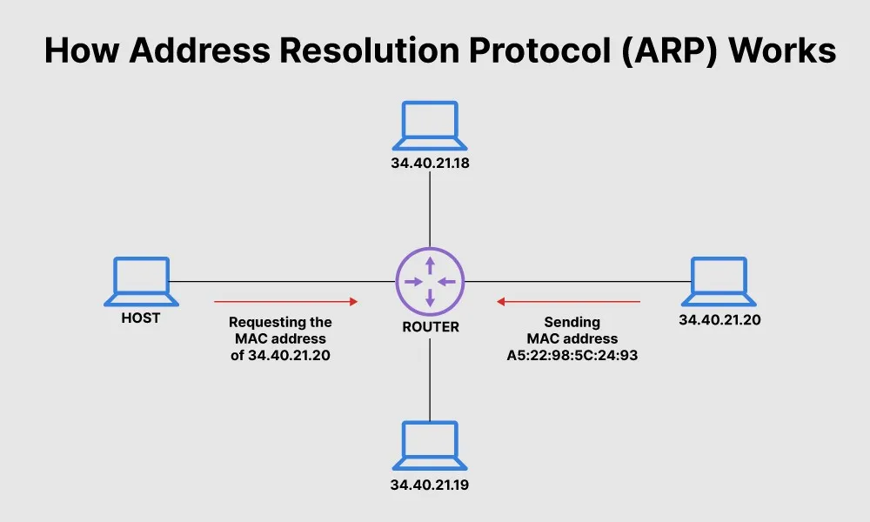
ARP

Slide 20
ARP Steps
Host sends ARP request to get the Mac address of devices on the network including its IP address.
The connected switch or router broadcast the request message to all connected devices on the LAN.
The device that has this IP address responds with its MAC address.
To scan the entire network, the host need to send ARP request to all devices on the network.

Slide 21
Network Scanner Code (Network Discovery)

Slide 22
ARP Spoofing

Slide 23
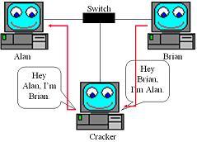
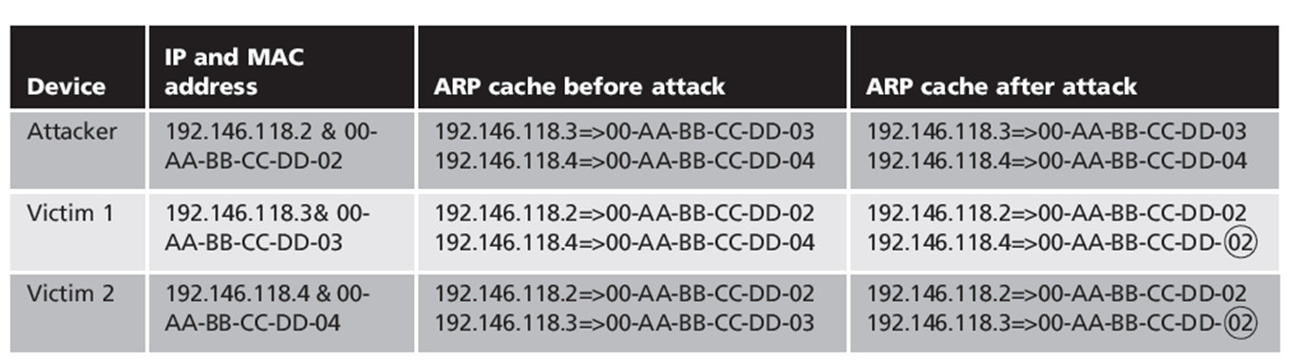
ARP Spoofing

Slide 24
What is ARP Spoofing (ARP Poisoning)
An ARP spoofing, also known as ARP poisoning, is a Man in the Middle (MitM) attack that allows attackers to intercept communication between network devices. The attack works as follows:
  The attacker must have access to the network. They scan the network to determine the IP addresses of at least two devices⁠—let’s say these are a workstation and a router.
  The attacker uses a spoofing tool, such as Arpspoof or Driftnet, to send out forged ARP responses.
  The forged responses advertise that the correct MAC address for both IP addresses, belonging to the router and workstation, is the attacker’s MAC address. This fools both router and workstation to connect to the attacker’s machine, instead of to each other.
  The two devices update their ARP cache entries and from that point onwards, communicate with the attacker instead of directly with each other.
  The attacker is now secretly in the middle of all communications.

Slide 25
ARP Spoofing In Python

Slide 26
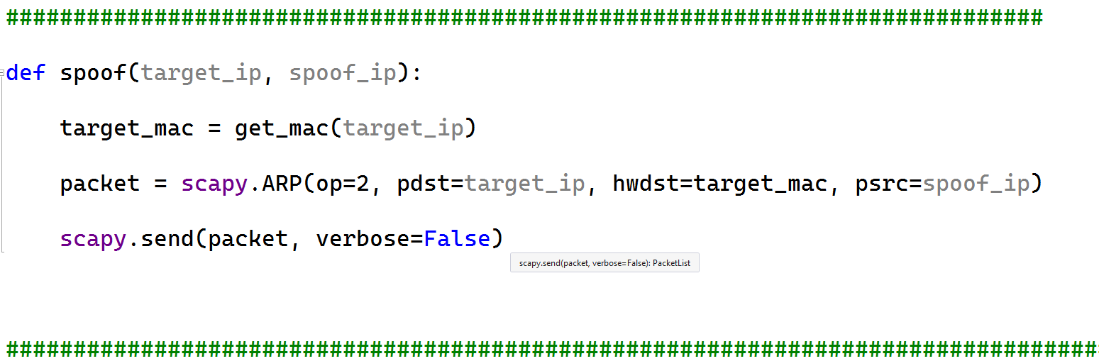
ARP Spoofing In Python

Slide 27
ARP Spoofing In Python

Slide 28
Note:
To run this program you have to:
    Enable IP-forwarding in Windows.
To check the ip address of the current device:
    Use ipconfig in the cmd
To check the devices connected to the LAN network
    Use arp -a
To install scapy.all use the command
    pip install scapy

Slide 29
Keyloggers

Slide 30
What is keyloggers
Keyloggers are a particularly insidious type of spyware that can record and steal consecutive keystrokes (and much more) that the user enters on a device.
The term keylogger, or "keystroke logger," is self-explanatory: Software that logs what you type on your keyboard.
Record all keystroke in a file and send the file at a certain time to the attackers

Slide 31
The Processes of Keyloggers
Listen
Record
Wait time
Send data

Slide 32
Keylogger : 1- Listen

Slide 33
Keylogger: 2-Record

Slide 34
Keylogger: 3- Wait Time
First:
  from threading import Timer

Slide 35
Keylogger: 3- Wait Time

Slide 36
Keylogger: 4- Send data
First
  From smtplib import SMTP

Slide 37
Keylogger: 4- Send data
https://myaccount.google.com/u/4/lesssecureapps

Slide 38
Hash Breaker.
Brute-force attack definition:
“An attack in which cybercriminals utilize trial-and-error tactics to decode passwords, personal identification numbers (PINs), and other forms of login data by leveraging automated software to test large quantities of possible combinations.”
Dictionary attack definition:
“A type of brute force attack where an intruder attempts to crack a password-protected security system with a “dictionary list” of common words and phrases used by businesses and individuals.”

Slide 39
Hash Breaker
In this work we introduce a hash breaker function that mainly utilizes the Dictionary Method.

Slide 40
Hash Breaker

